Slide 1
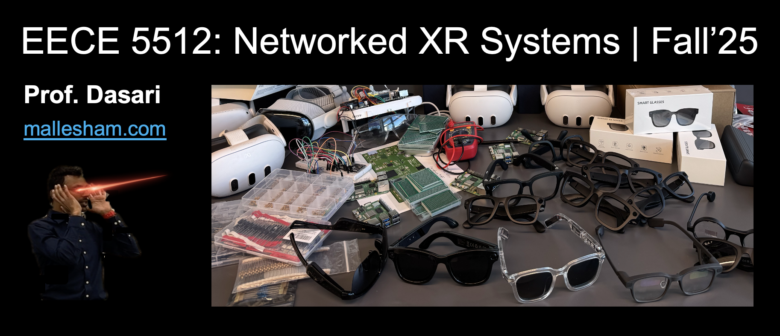


Spatial Intelligence Research Group
sinrg.org

Slide 2
Lecture Outline for Today
Logistics
Quiz (not for grading)
Schedule, Instructor info
Grading, Communication, Expectations
Introduction to XR
Basics of Networked XR systems

Slide 3

Short Anonymous Quiz (Not for grading)
https://forms.gle/V7HzSPeJwgS1cM4o9

Slide 4
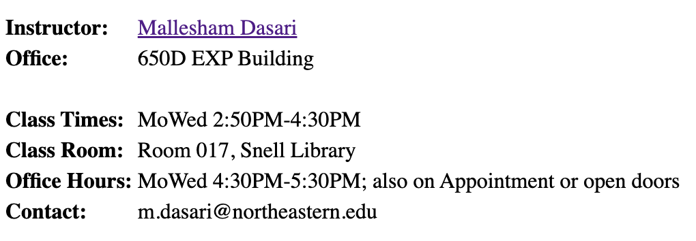
Schedule and Instructor Info
Room 256, Richards Hall
Course Webpage: https://mallesham.com/courses/eece5512/fall25/index.html

Slide 5
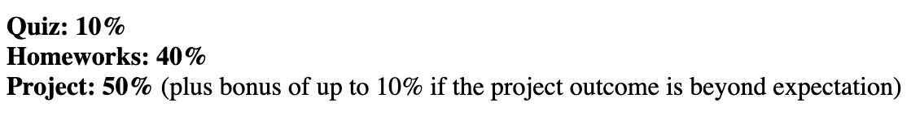
Grading
All deadlines are due 5pm unless otherwise specified

Slide 6
Late Days
Quizzes - 5
No late days
Homework - 4
4 late days in total across all of them
Project - 1
Demo and a presentation
Last day of class or exam week

Slide 7
Homework and Project
Most homework will be programming
No restrictions on language – C/C++, Python, C#, JavaScript, Java, etc.
Individual (or max 2 team) project
Project type
Implement a research paper that is already been published
Conduct a measurement study - experimental
Research project

Slide 8
Experience Sessions
Exploring XR tools
Headsets
Apps
Software
Demos of research prototypes
Exploring 3D, immersive, spatial content

Slide 9


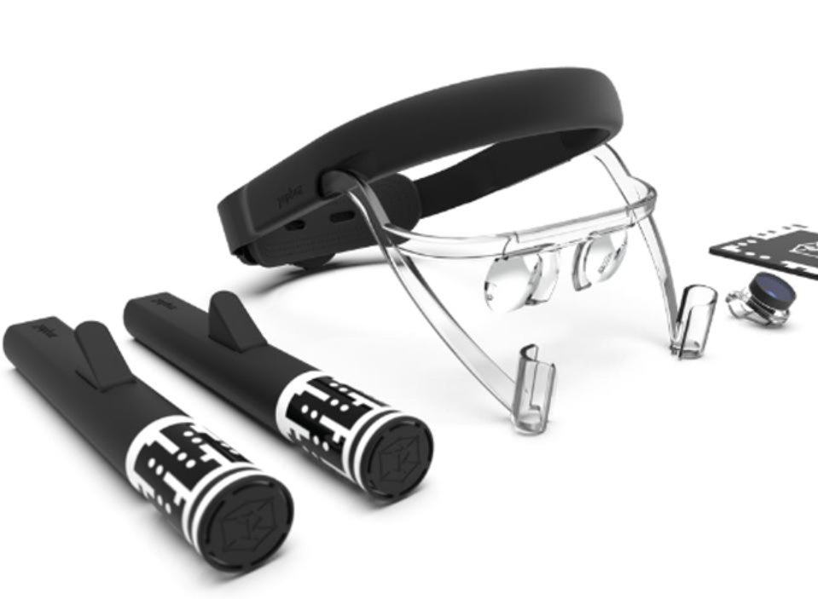
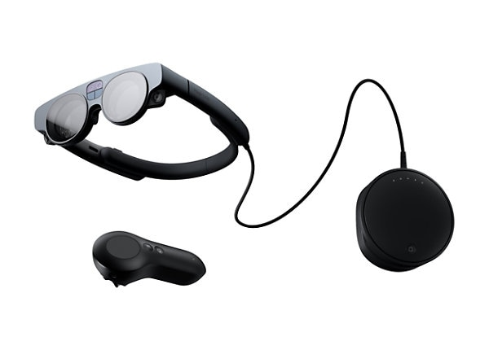


Experience Sessions

Slide 10
Communication and Support
Slack
Canvas
Piazza?

Slide 11
University Statements
Student Accommodations
Disability services
Academic Integrity
You are allowed to use AI or any tools that you may need help for homework and projects (with a caution – AI can generate garbage sometimes, so it is your responsibility to make sure you’re not blindly following what AI is telling you to do)
Acknowledge sources

Slide 12
This Class is About
Building Networked Immersive Experiences
Hardware – XR Headsets, Glasses, Sensors, Devices
Software - 3D Development tools, Programming Languages.
Algorithms – 3D reconstruction, compression, network protocols, streaming methods.

Slide 13
This Class is Not About
Computer Graphics
3D Modeling, Rendering, Geometry Manipulation
Computer Vision
SLAM, Image Feature Extraction, Face Recognition, Classification, Segmentation, Object Detection, etc.
Computer Networks
Wireless, Cellular, Wide Area Internet Protocols
Routing, Congestion Control
Physical Layer, MAC Layer

Slide 14
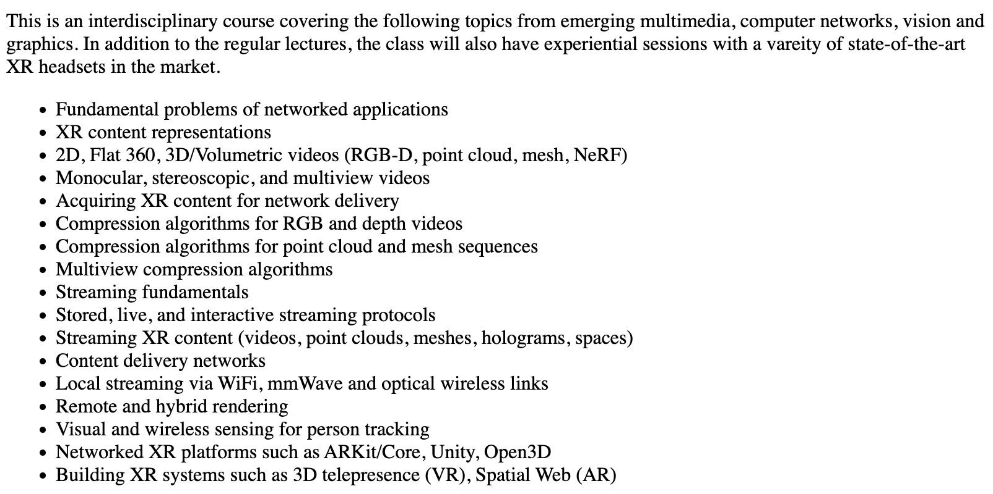
Tentative Topics

Slide 15
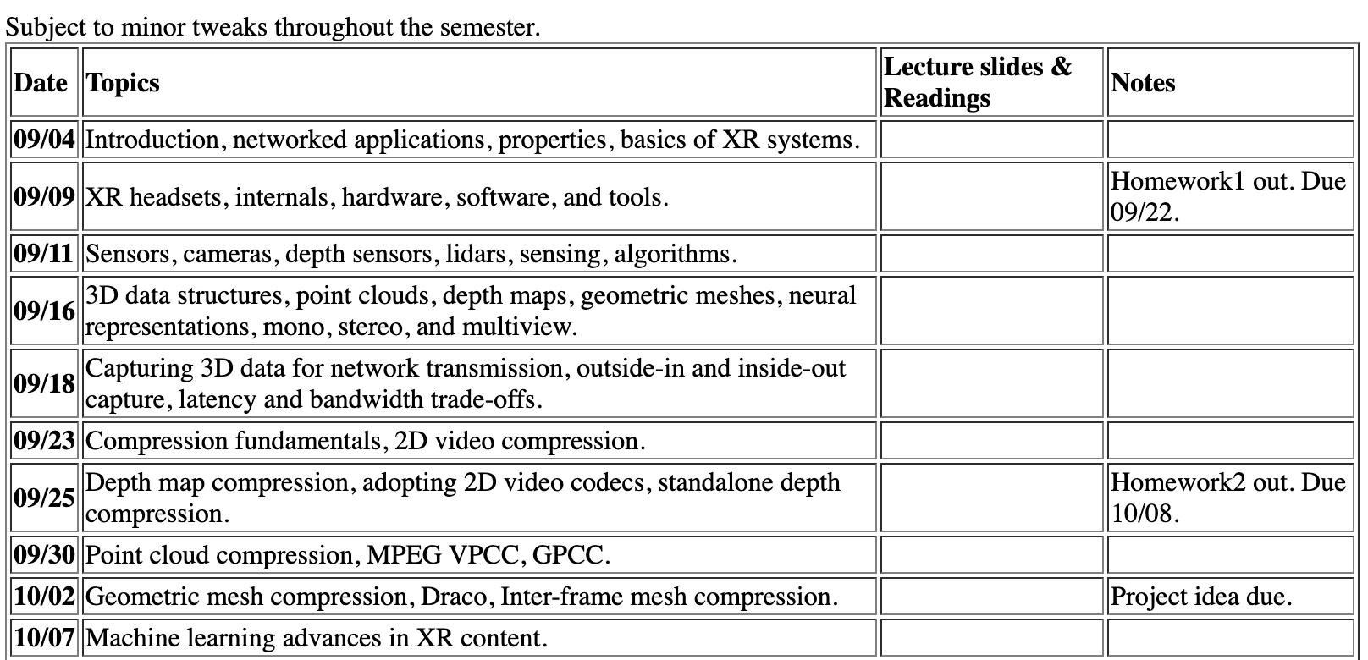
Tentative Schedule

Slide 16
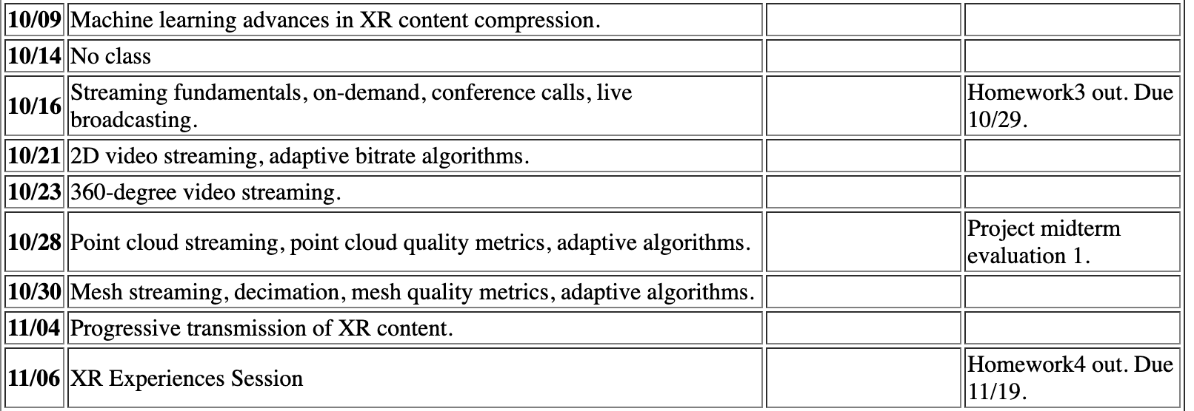
Tentative Schedule

Slide 17
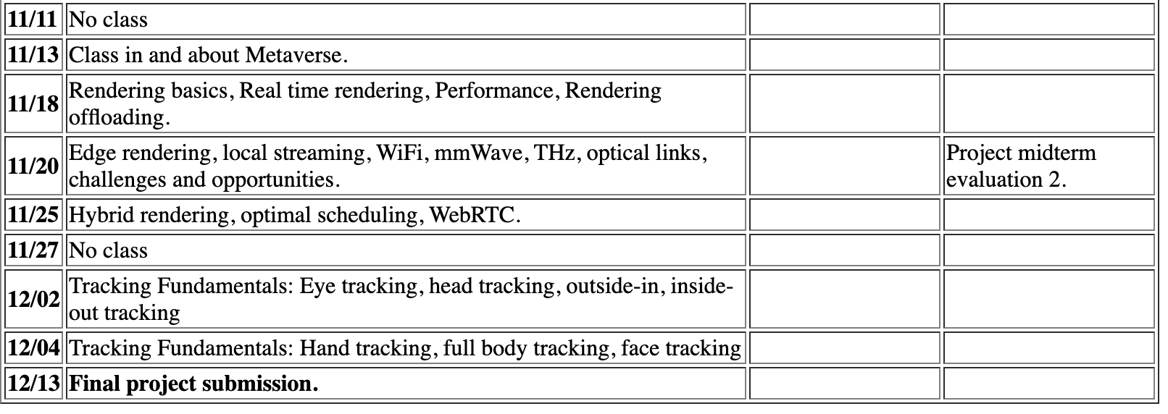
Tentative Schedule

Slide 18
Lecture Outline
Logistics
Schedule, Instructor info
Grading, Communication, Expectations
Introduction to XR
Basics of Networked XR systems
Any Questions?

Slide 19
What is XR (Extended Reality)?
A catch-all phrase for AR, VR, MR…
Textbook definition: Bring digital world to our physical world

Slide 20


What is XR (Extended Reality)?
”real” is simply electrical signals interpreted by your brain

Slide 21
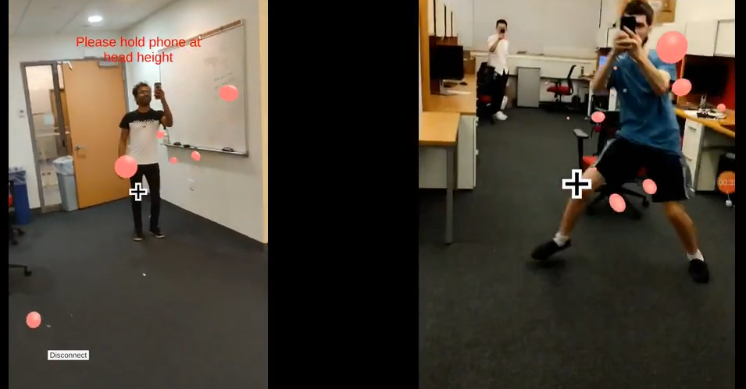
Augmented Reality
Overlays digital content in the physical world

Slide 22
Augmented Reality
Variety of platforms
Smartphones, Headsets, Glasses
Requires continuous tracking
Hands, Body, Person
Display methods
Video see-through
Optical see-through

Slide 23
Mixed Reality
Same as Augmented Reality
Microsoft tried to rebrand it for marketing
Interaction highlighted

Slide 24

Virtual Reality
Completely immersed in digital world

Slide 25
Virtual Reality
Platforms
Only HMDs or VR Glasses; Near-eye Displays
Motion tracking
Head, Eyes, Face, Body, Hands, Gestures, etc
Other than visual sensors
Sound, Tactile Feedback for touch

Slide 26
AR vs. MR vs. VR vs. XR
AR = Virtual + Physical
MR = AR (or interactive AR)
VR = Purely Virtual
XR = A catch all term for all of the above
Metaverse – Meta
Spatial Computing – Apple
Immersive Computing - Academia
Digital Twins

Slide 27
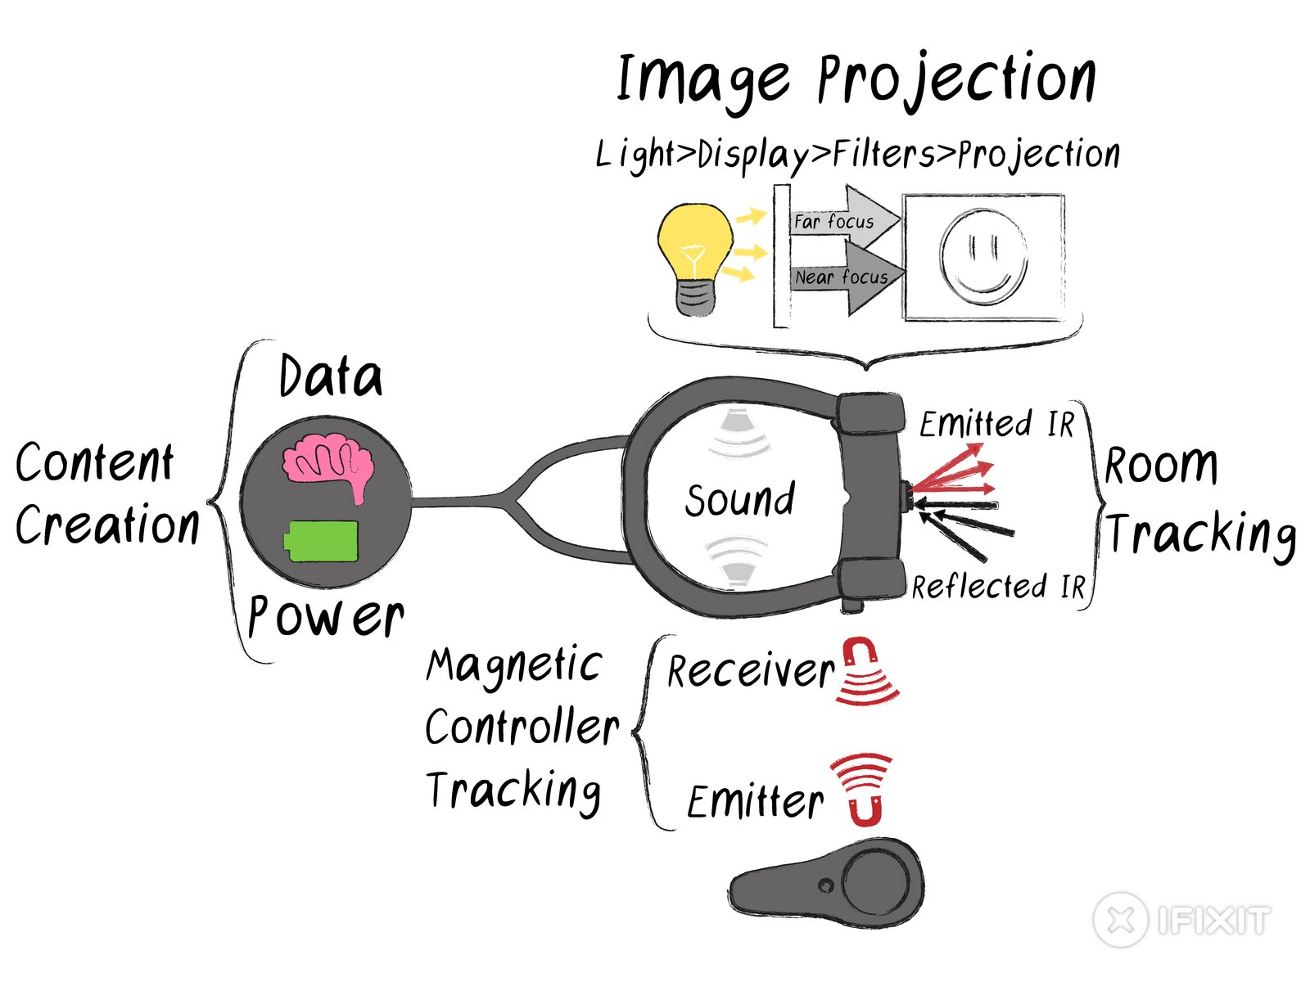
XR Hardware
Sensors
Display
Compute Pack
https://www.ifixit.com/Teardown/Magic+Leap+One+Teardown/112245

Slide 28
XR Software
Rendering Engines
Unity, Unreal
WebGL
3D modeling tools
Blender
Maya
User Interfaces
Programmable 3D Manipulation Frameworks
Open3D

Slide 29
XR Algorithms
Sensing and Tracking
Eyes, Face, Hands, Head, Body...
3D Reconstruction
Efficiently extract 3D geometry from raw sensor data
From depth data or point cloud data form Lidars
Real-time rendering algorithms
Decimation

Slide 30

Leading Companies of XR
Many startups…

Slide 31

XR Applications - Gaming
Indoor games too

Slide 32
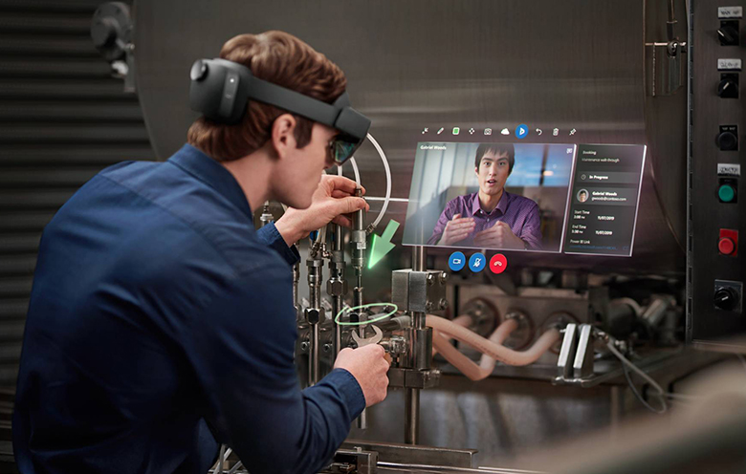
XR Applications – Remote Assist
Hands free Facetime

Slide 33

XR Applications - Medical
Visualize 3D data in thin air

Slide 34
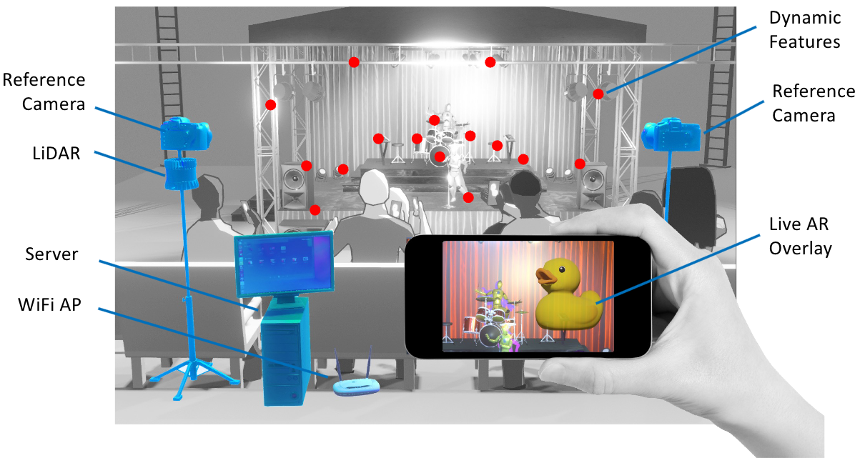
XR Applications - Entertainment
Theater performances

Slide 35
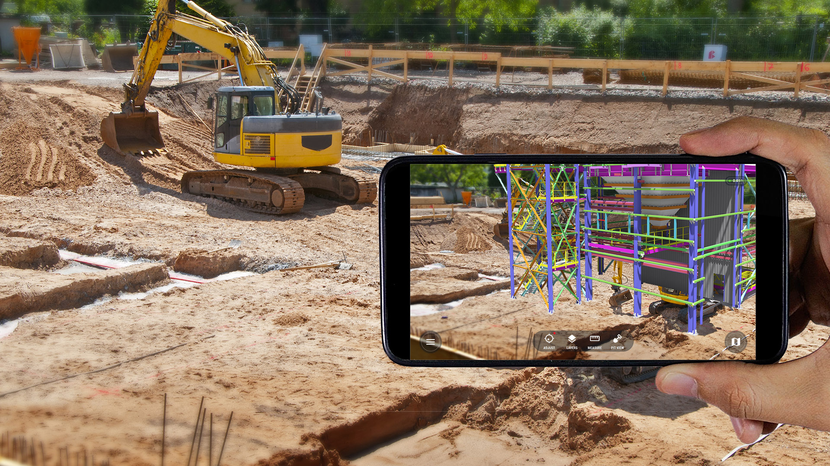
XR Applications - Engineering

Slide 36
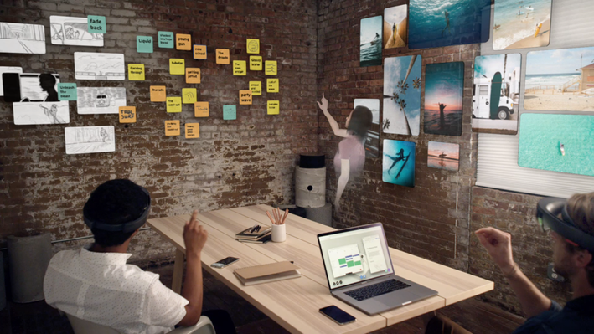
XR Applications – Telepresence
Previously: Large displays, Telepresence robots, etc..

Slide 37
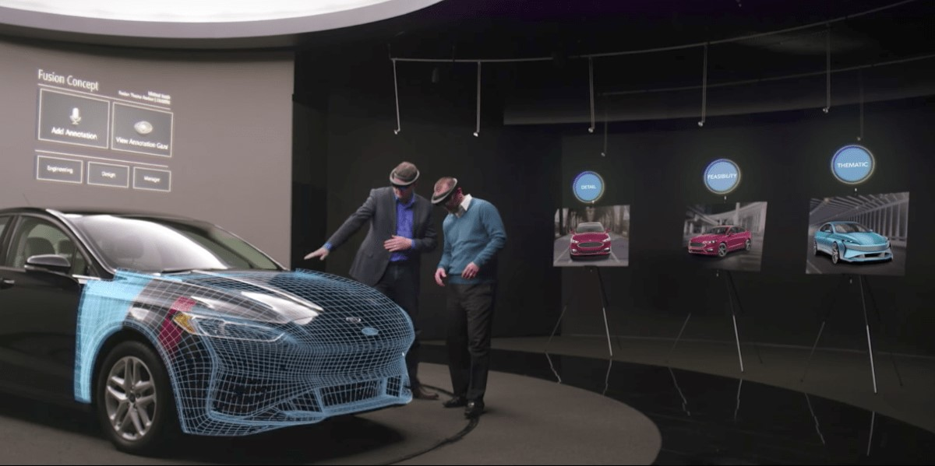
XR Applications - Automotive

Slide 38
XR Systems in Use Today
Horizon Worlds – Meta
VRChat
Mozilla Hubs
AltspaceVR – dead
Many Games
Retail, housing markets have started using 3D models of objects and houses for showing in VR
Collaborative Virtual Environments

Slide 39
Lecture Outline
Logistics
Schedule, Instructor info
Grading, Communication, Expectations
Introduction to XR
Basics of Networked XR systems
Any Questions?

Slide 40
The Need for Network
Long Distance Communication
Accessing Remotely Stored Content
Accessing Distributed Resources

Slide 41
Networked Systems
Voice and Video Calls
Facetime, Zoom, Teams
Streaming Content On-demand
YouTube, Netflix, Tiktok
Cloud compute and storage
Printers, and other smart devices communication
XR Systems?

Slide 42

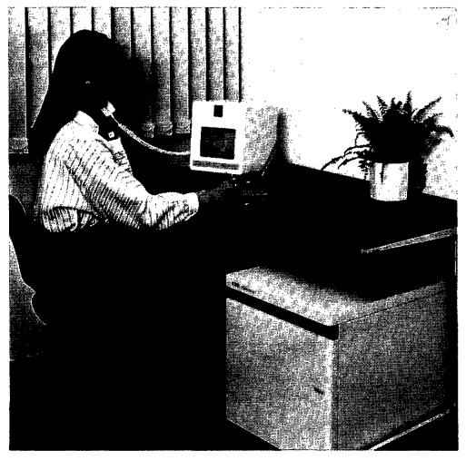
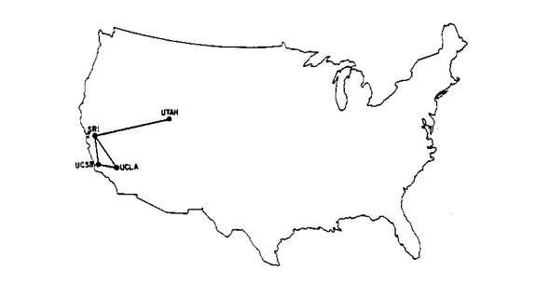

A Brief History of Networked XR Systems – 1970 & 1980
Early attempts of content delivery over the Internet
The Internet
Progressive Image Transmission
Teleconference [64Kbps]

Slide 43
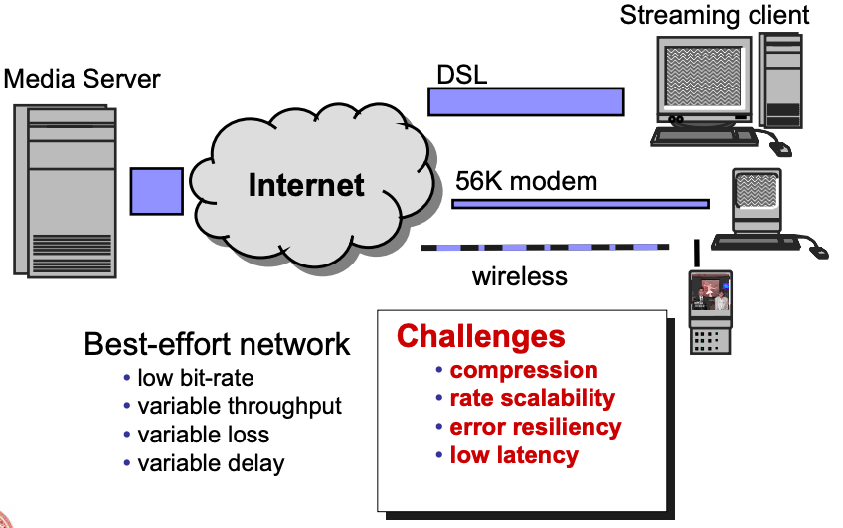
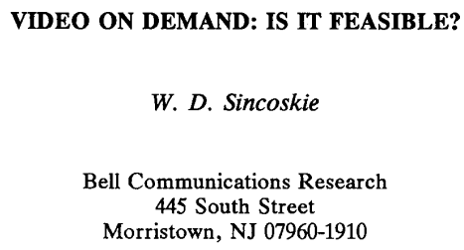
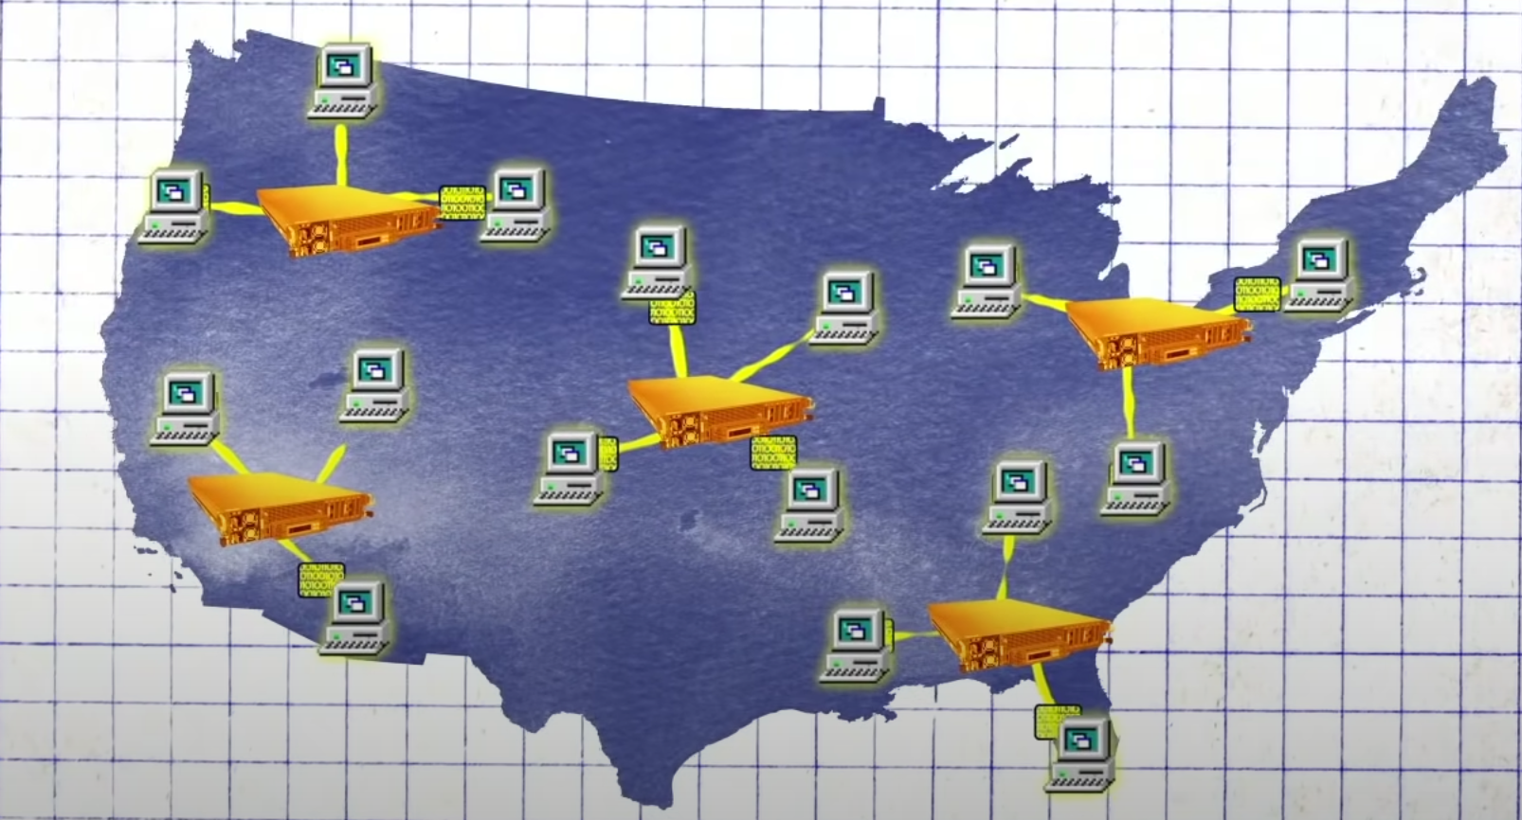
A Brief History of Networked XR Systems – 1990 & 2000
Globecom’1990
Early attempts in on-demand video delivery
Powerful compute, storage, hardware capacity
Video compression (MPEG-1)
Internets
Progressive Downloads
https://www.youtube.com/watch?v=OV3legWSi6U

Slide 44
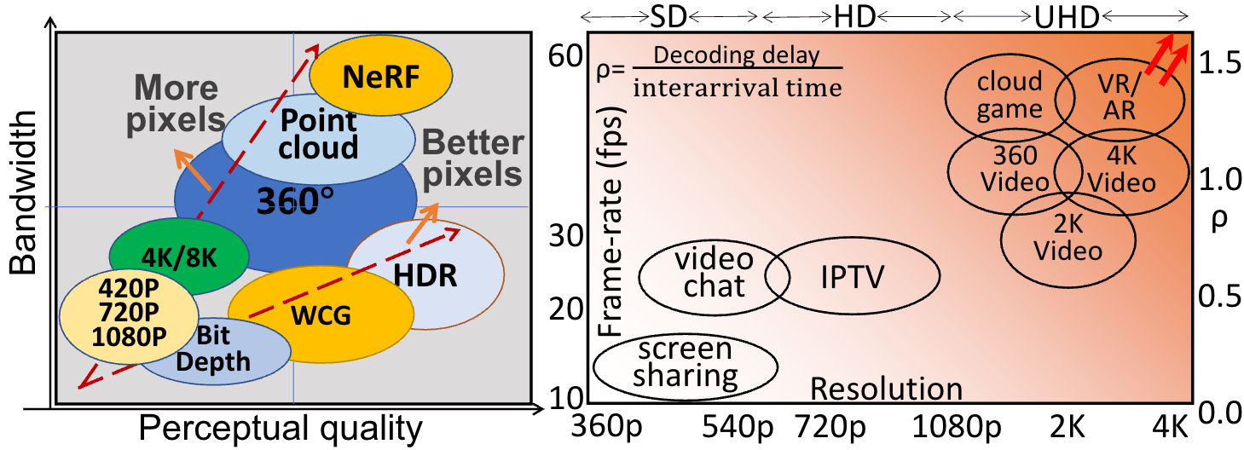
A Brief History of Networked XR Systems – 2010 & 2020
Despite the advances in computer networks, they are still a bottleneck

Slide 45
Fundamental Problems of Networked XR Systems
Network bandwidth
Bandwidth variability
Latency
Power consumption

Slide 46
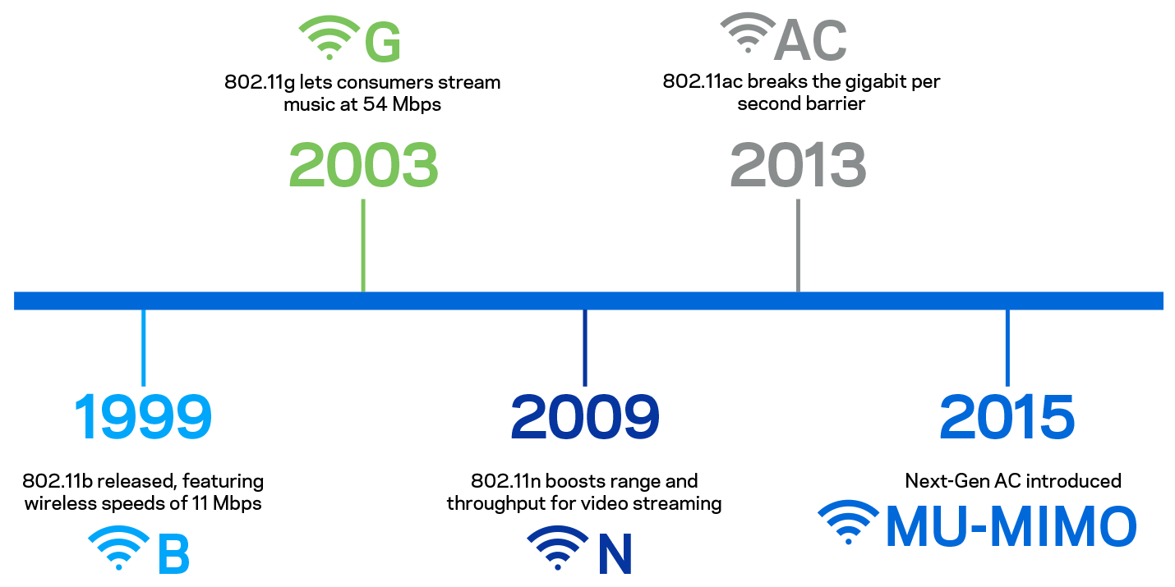
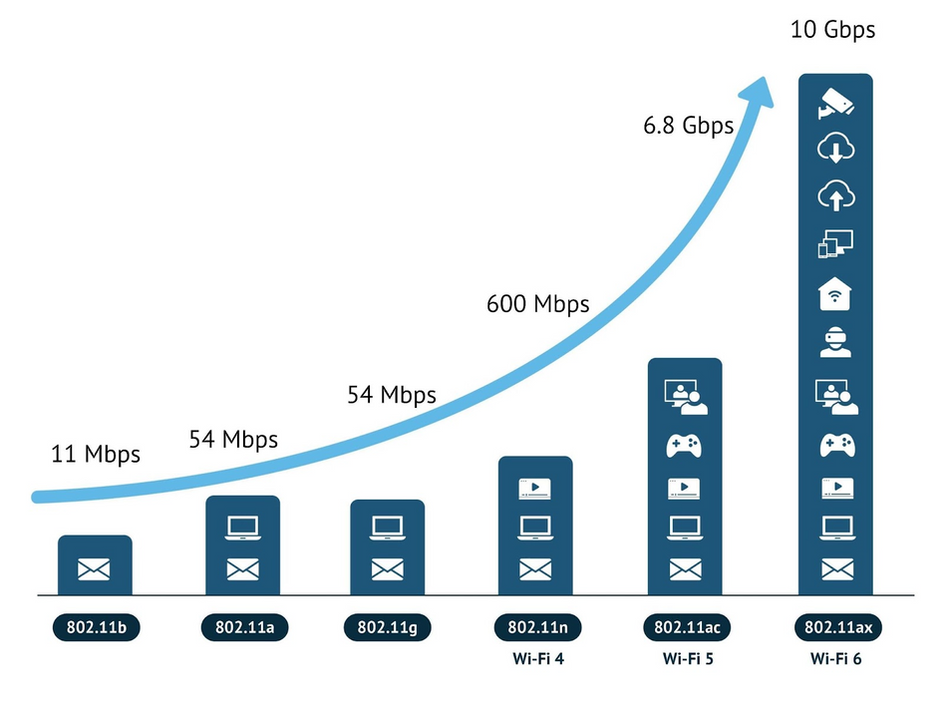
Network Bandwidth - WiFi

Slide 47
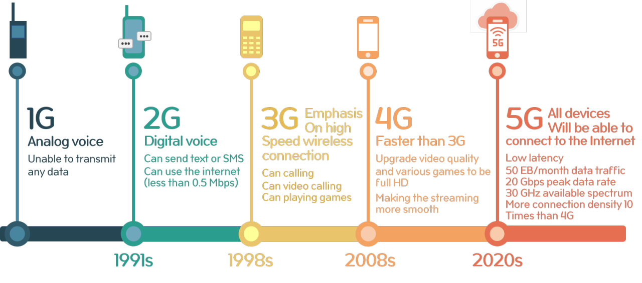
Network Bandwidth - Cellular

Slide 48
Network Bandwidth
A high quality XR system requires a few dozens of Gbps to stream interactive 3D content
Few dozens of Mbps

Slide 49
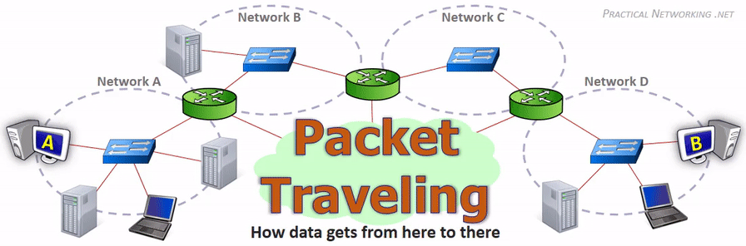
Network Latency
Processing
Transmission
Queueing
Propagation
https://www.practicalnetworking.net/series/packet-traveling/packet-traveling/

Slide 50
Network Latency - Processing
Application processing
Preparing and packaging data into bits and packets
Network stack
Packets are copied and processed at each layer before passing to the transmission (physical) layer
Example Application
Video Streaming

Slide 51
Network Latency - Transmission
Radio takes time to transfer bits onto the transmission medium
Wire
Wireless – WiFi/Cellular Radios
Depends on the device and chip

Slide 52
Network Latency - Queueing
Routers often have large queues of packets
Shallow buffers
Deep buffers
Trade-offs?

Slide 53
Network Latency - Propagation
Light speed is the limit on packet time of flight
Boston to London – 3000 miles, ~16ms
Boston to Bombay – 10000 miles, ~40ms (ideal)
Impossible to send a packet faster than this latency

Slide 54
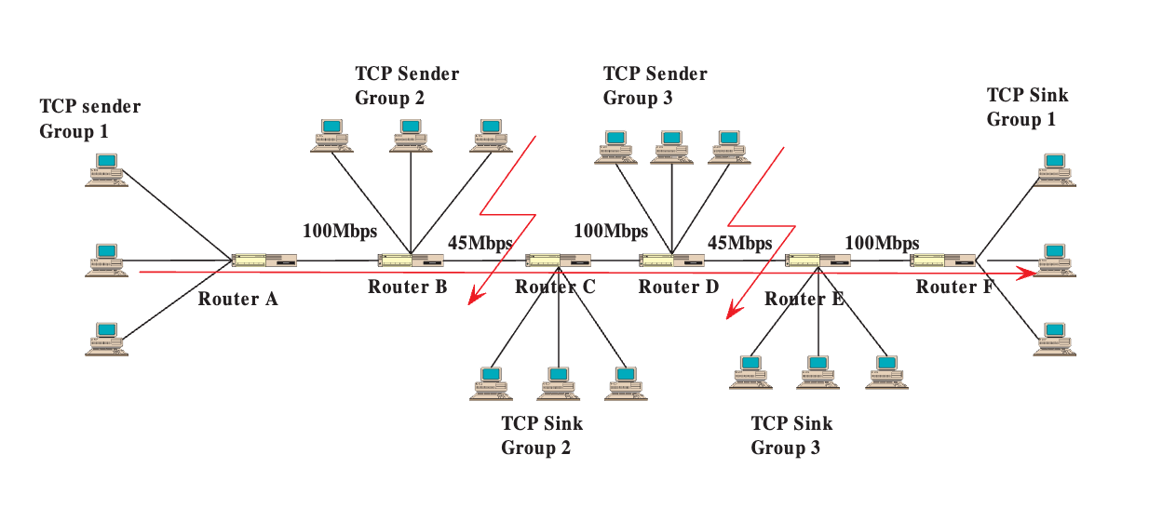
Routers and Switches as Bottlenecks
Packets are transported from place to another through multiple hops

Slide 55
Network and Application Synchronization
Application vs. TCP congestion control
Mismatch in sending data rate
Example
Video streaming application wants send at 100Mbps rate
Transport protocol sends at 10Mbps – Packet drops
Solution?

Slide 56
Power Consumption
Application-level power consumption
Example
3D rendering
Video encoding or decoding
Display

Slide 57
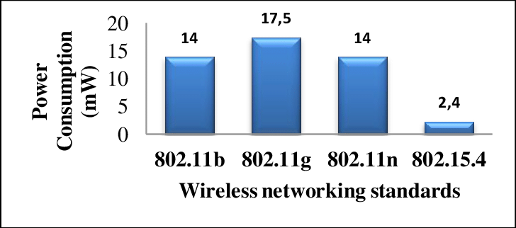
Power Consumption
Network packet processing
Radio is one of the most power-hungry components

Slide 58
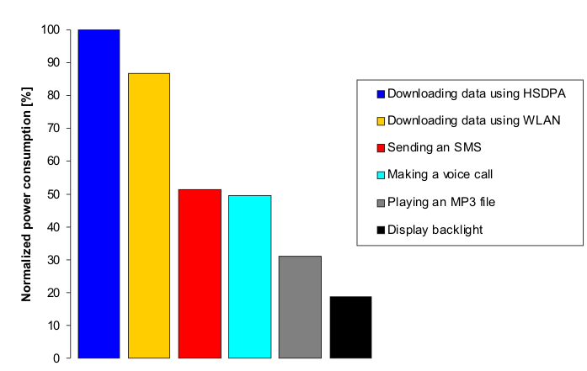
Power Consumption
Cellular radio consumes more power than WiFi
Perrucci et.al 2009

Slide 59
Summary of the Lecture
Logistics
Schedule, Instructor info
Grading, Communication, Expectations
Introduction to XR
Basics of Networked XR systems
Any Questions?

